Slide 1

CME538 Introduction to Data Science
Week 2 | Lecture 3 (2.3)
Pandas III.

Slide 2

Pandas III
Lambda Functions
Iterating
Merging

Slide 3
Pandas III
Lambda Functions
Iterating
Merging

Slide 4
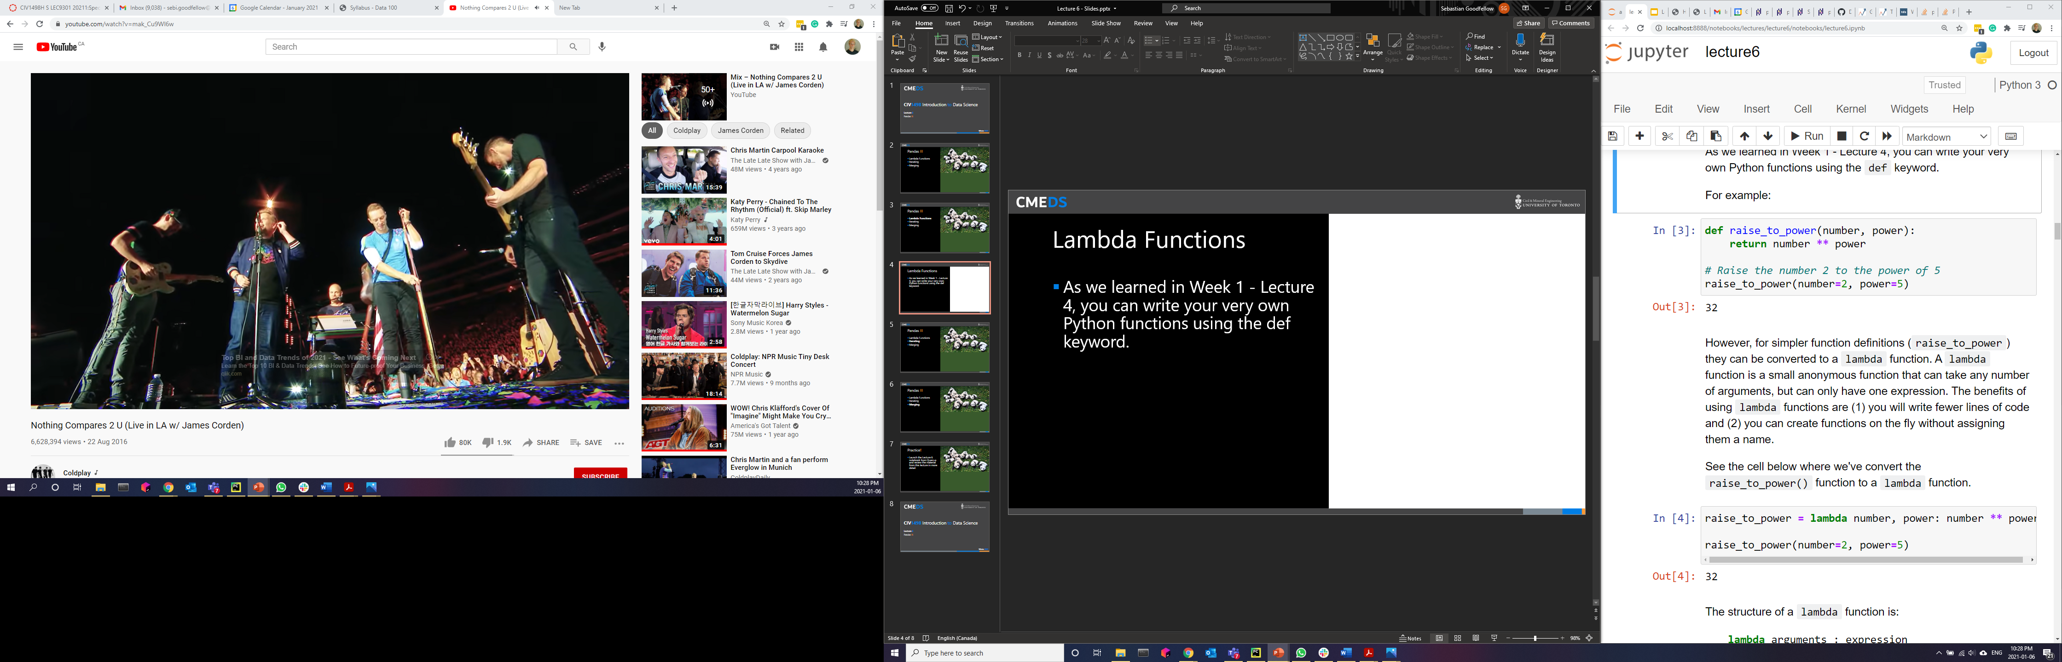
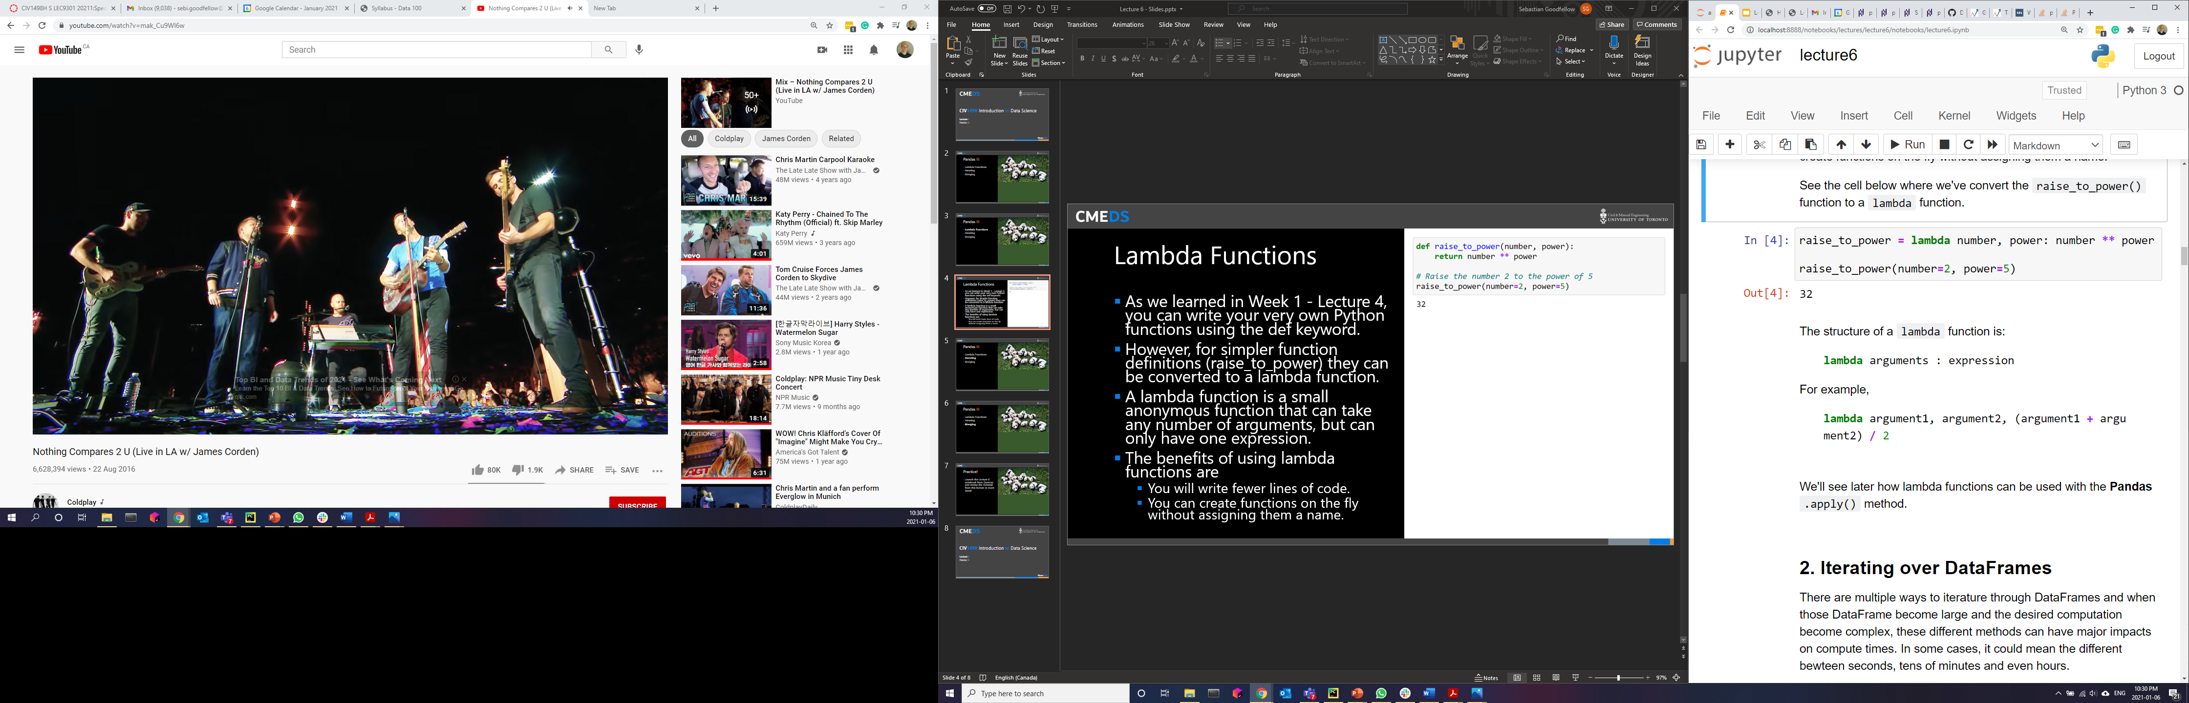
Lambda Functions
As we learned in Week 1 - Lecture 1.3, you can write your very own Python functions using the def keyword.
However, for simpler function definitions (raise_to_power) they can be converted to a lambda function.
A lambda function is a small anonymous function that can take any number of arguments, but can only have one expression.
The benefits of using lambda functions are:
You will write fewer lines of code.
You can create functions on the fly without assigning them a name.

Slide 5
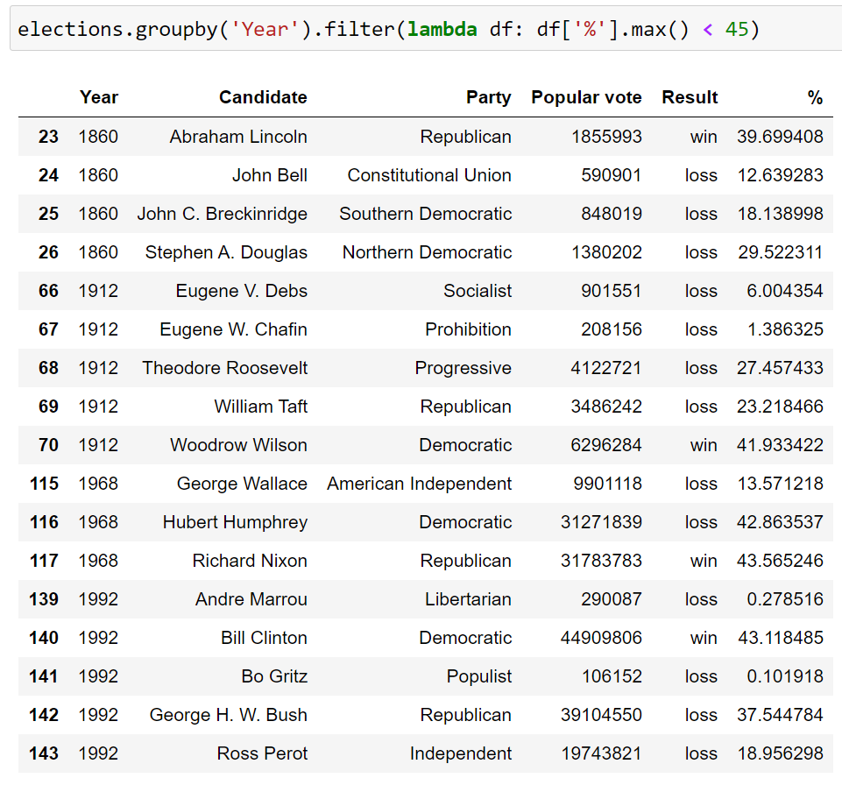
Lambda Functions
Lambda Function!
We use lambda functions all the time with Pandas.
We’ll use it with the .apply() method in the next section.
def my_func(df):
return df[%].max() < 45
OR
lambda df: df[%].max() < 45

Slide 6
Pandas III
Lambda Functions
Iterating
Merging

Slide 7
Iterating
There are multiple ways to literate through DataFrames and when those DataFrame become large and the desired computation become complex, these different methods can have major impacts on compute times.
In some cases, it could mean the different between seconds, tens of minutes and even hours.

Slide 8
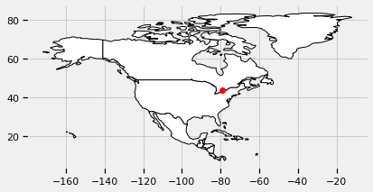
Iterating
Do illustrate this, let’s start with a simple problem.
Let’s say we want to calculate the straight-line distance between 100,000 random geo-positions (latitude, longitude) and the city of Toronto.
Toronto
(lat: 43.651070 lon: -79.347015)

Slide 9
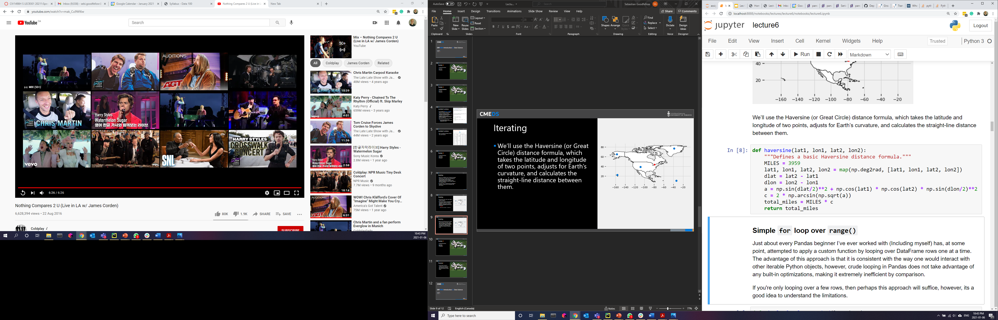
Iterating
We’ll use the Haversine (or Great Circle) distance formula, which takes the latitude and longitude of two points, adjusts for Earth’s curvature, and calculates the straight-line distance between them.

Slide 10
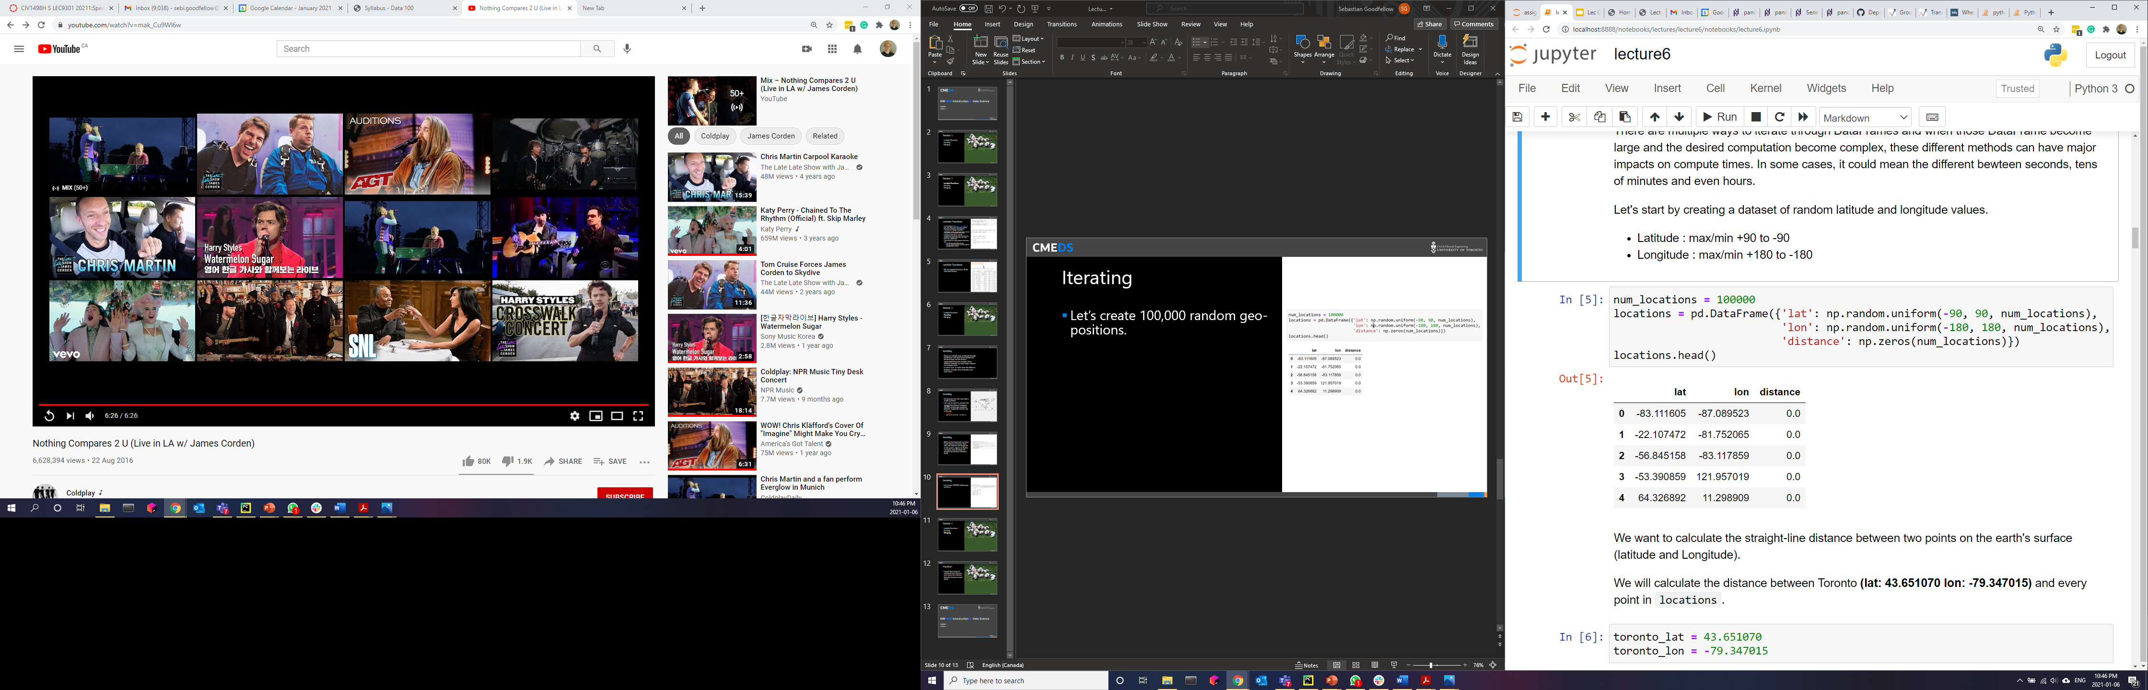
Iterating
Let’s create 100,000 random geo-positions.

Slide 11
Iterating
Distance
Our task is to loop through these random geo-positions and calculate the distance between them and Toronto.
Toronto
lat: 43.651070
lon: -79.347015
Point
lat: -83.111605
lon: -87.089523

Slide 12
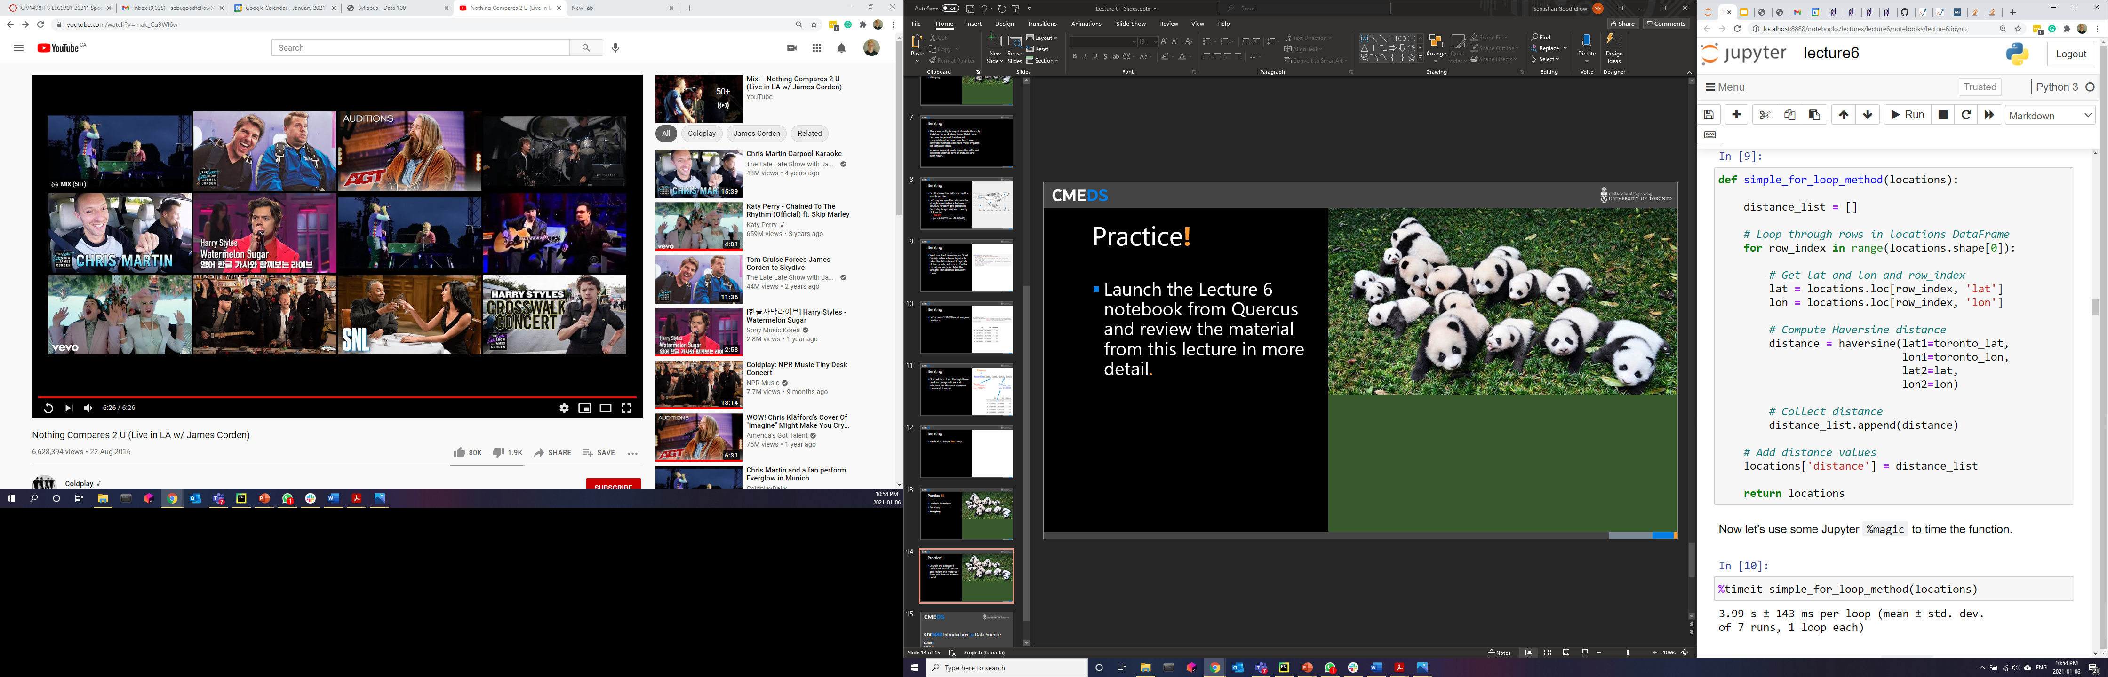
Iterating
Method 1: Simple for Loop over range()
Just about every Pandas beginner I’ve ever worked with (Including myself) has, at some point, attempted to apply a custom function by looping over DataFrame rows one at a time.
The advantage of this approach is that it is consistent with the way one would interact with other iterable Python objects, however, crude looping in Pandas does not take advantage of any built-in optimizations, making it extremely inefficient by comparison.

Slide 13
Iterating
Method 1: Simple for Loop over range()
Using a simple for loop and the range() function, it took 3.99 seconds to iterate through 100,000 rows.

Slide 14
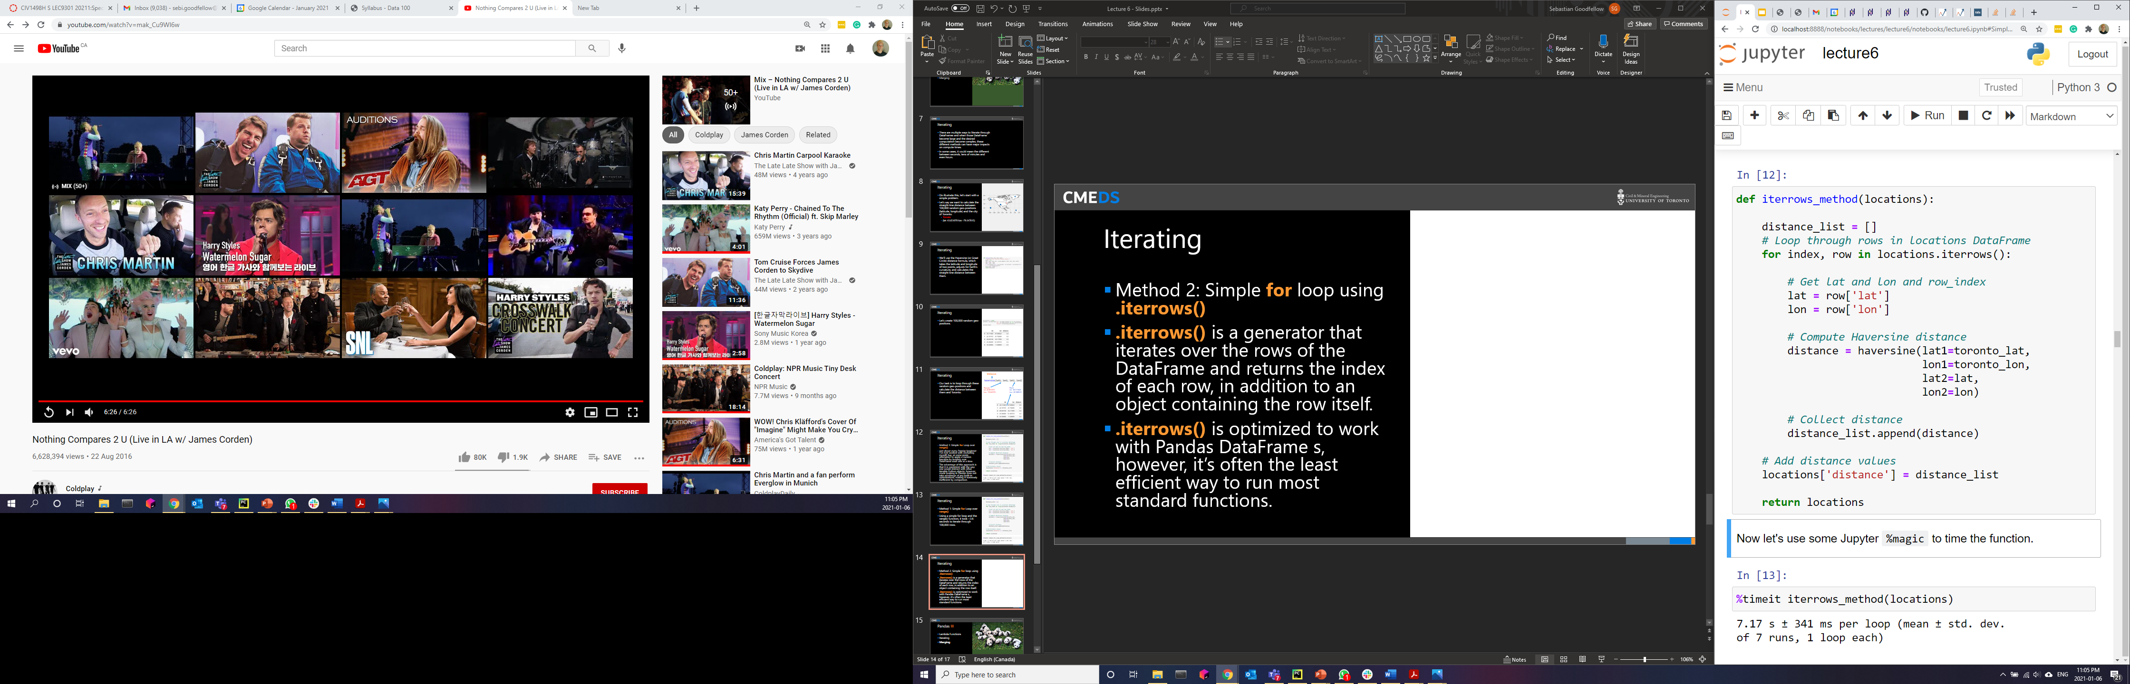
Iterating
Method 2: Simple for loop using .iterrows()
.iterrows() is a generator that iterates over the rows of the DataFrame and returns the index of each row, in addition to an object containing the row itself.
.iterrows() is optimized to work with Pandas DataFrames, however, it’s often the least efficient way to run most standard functions.

Slide 15
Iterating
Method 2: Simple for loop using .iterrows()
Using the Pandas .iterrows() function, it took 7.17 seconds to iterate through 100,000 rows, which is over twice as long as the simpler method.

Slide 16
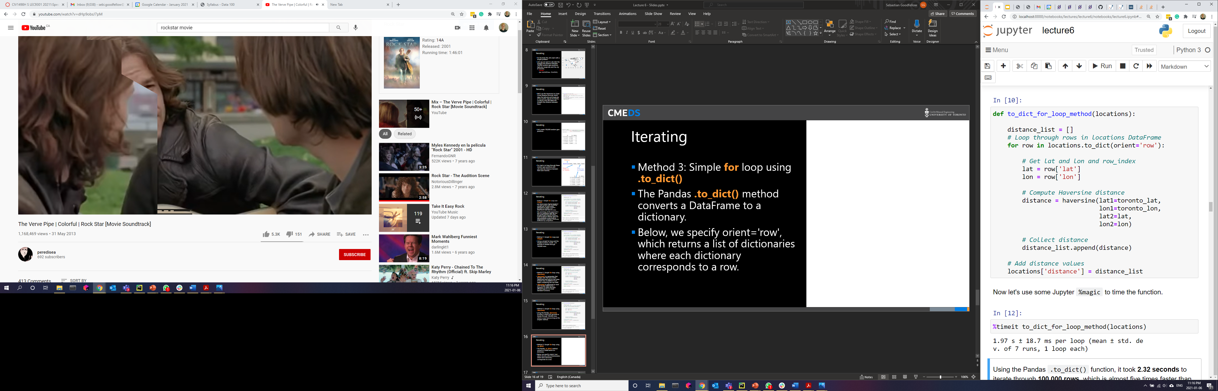
Iterating
Method 3: Simple for loop using .to_dict()
The Pandas .to_dict() method converts a DataFrame to a dictionary.
We specify orient='row', which returns a list of dictionaries where each dictionary corresponds to a row.

Slide 17
Iterating
Method 3: Simple for loop using .to_dict()
Using the Pandas .to_dict() function, it took 1.97 seconds to iterate through 100,000 rows, which is almost five times faster than .iterrows().

Slide 18
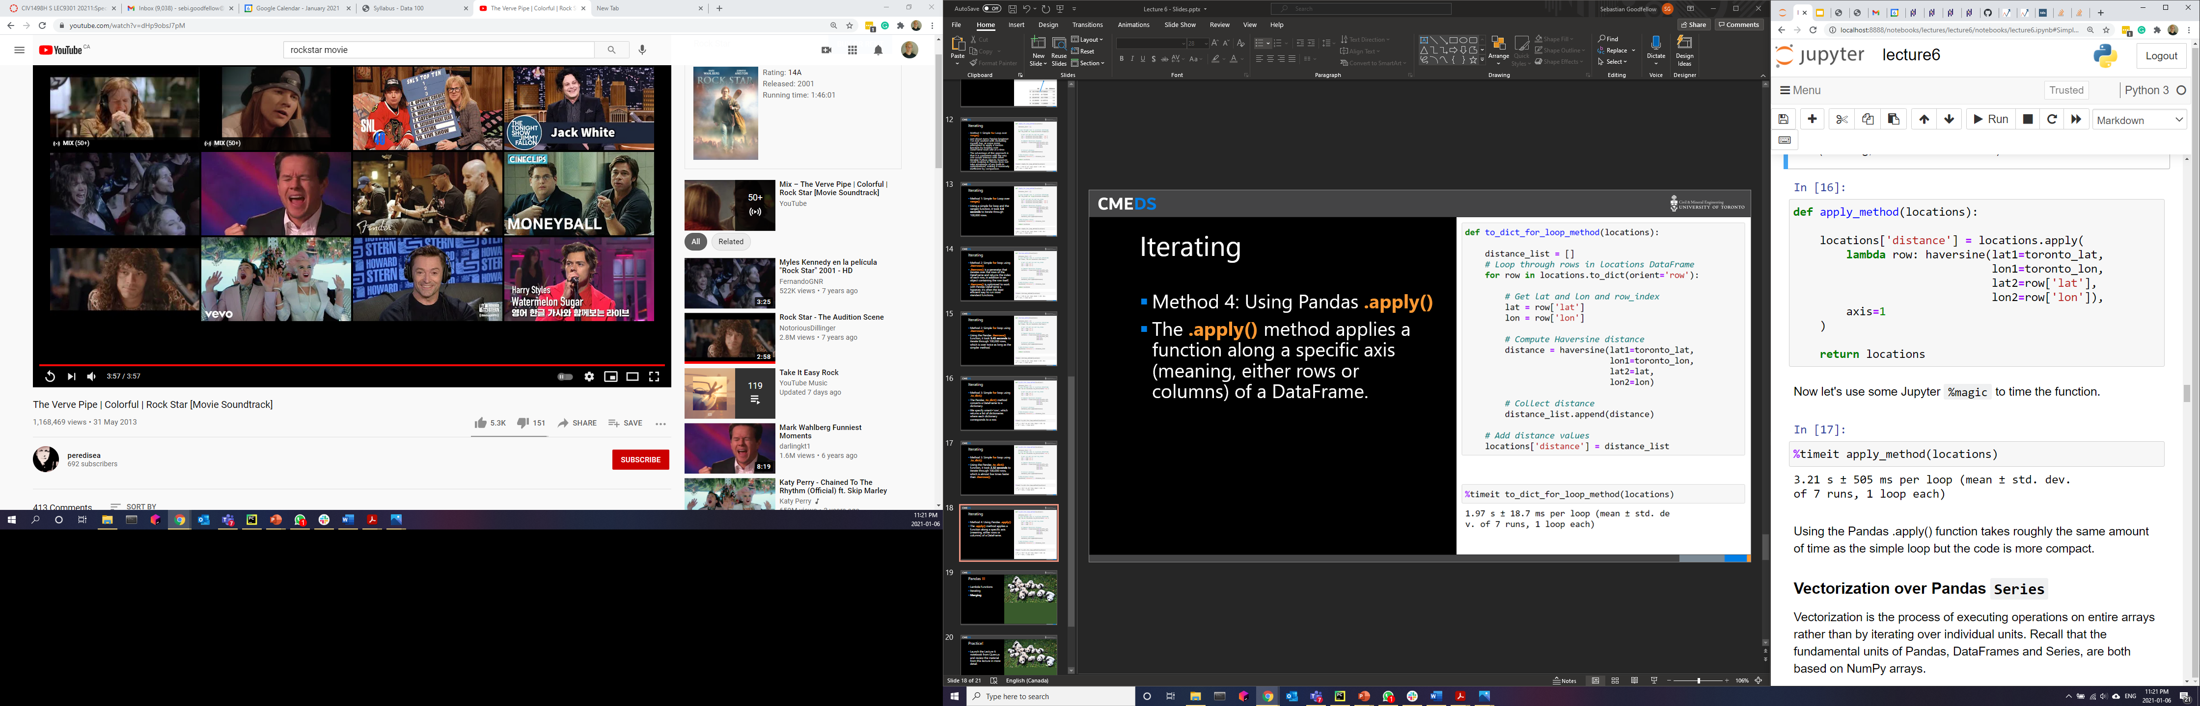
Iterating
Method 4: Using Pandas .apply()
The .apply() method applies a function along a specific axis (meaning, either rows or columns) of a DataFrame.
Using the Pandas .apply() function takes roughly the same amount of time as the simple loop but the code is more compact.

Slide 19
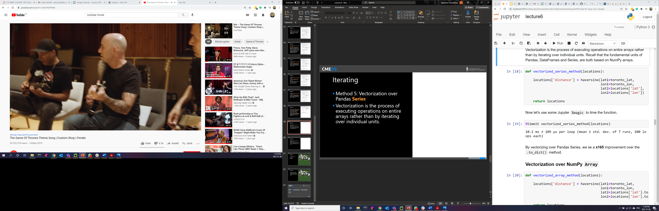
Iterating
Method 5: Vectorization over Pandas Series
Vectorization is the process of executing operations on entire arrays rather than by iterating over individual units.
By vectorizing over Pandas Series, we see a x165 improvement over the .to_dict() method.

Slide 20
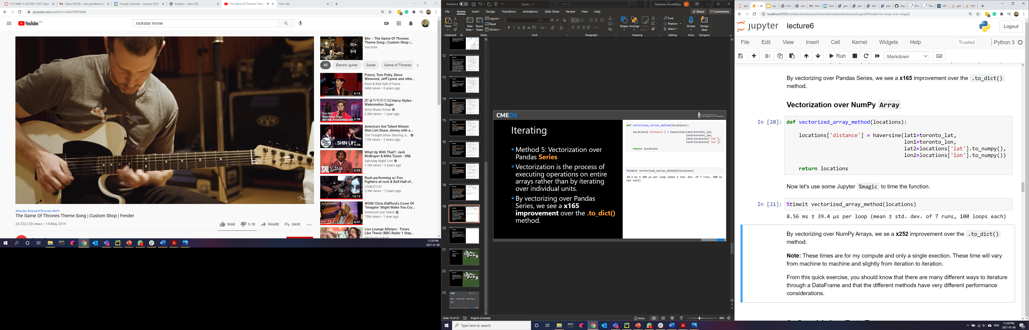
Iterating
Method 6: Vectorization over NumPy Array
Recall that the fundamental units of Pandas, DataFrames and Series, are both based on NumPy arrays.
By vectorizing over NumPy Arrays, we se a x252 improvement over the .to_dict() method.

Slide 21
Iterating
From this quick exercise, you should know that there are many different ways to iterate through a DataFrame and that the different methods have very different performance considerations.
Every application has different performance requirements.
When writing code, you want it to be:
Performant
Modular
Easy to understand

Slide 22
Pandas III
Lambda Functions
Iterating
Merging

Slide 23
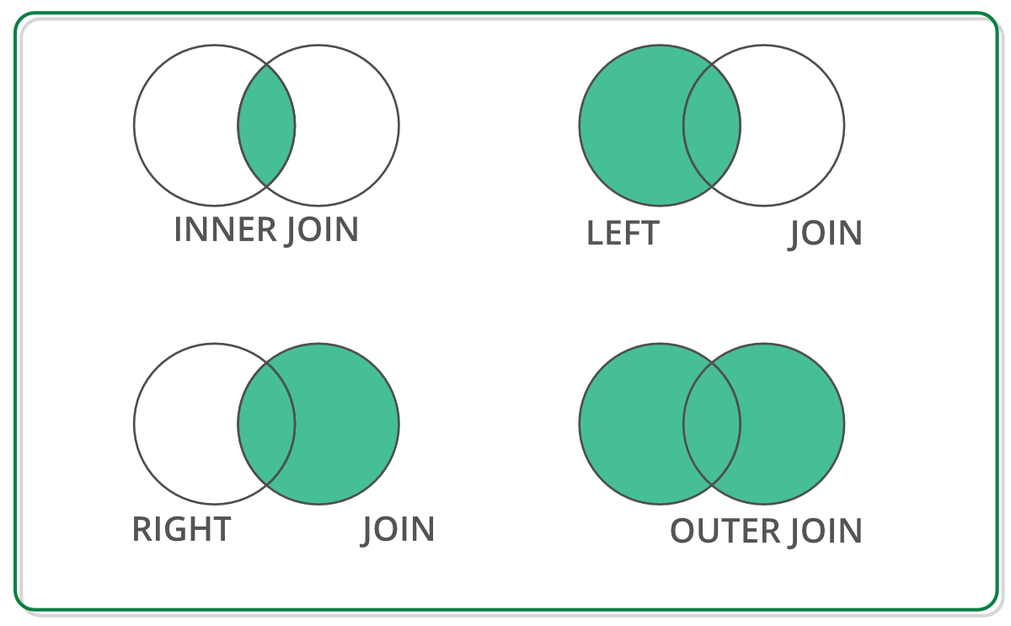
Merging
When conducting exploratory data analysis (EDA), its common that the data we want to use comes in multiple files/sources and will need to be combined.
In assignment 4, you’ll have to combine bike share ridership data with City of Toronto weather data.

Slide 24
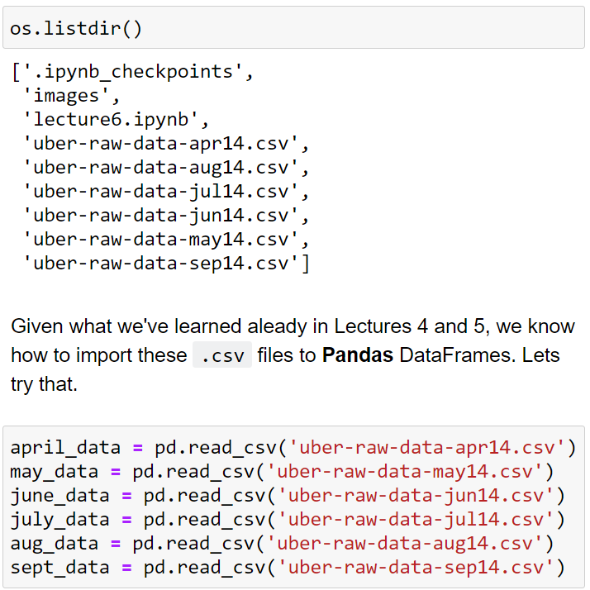
Merging
Let’s start with an example.
In the Lecture 6 folder, there are six .csv files from Uber showing monthly ridership numbers from April 2014 to September 2014.

Slide 25
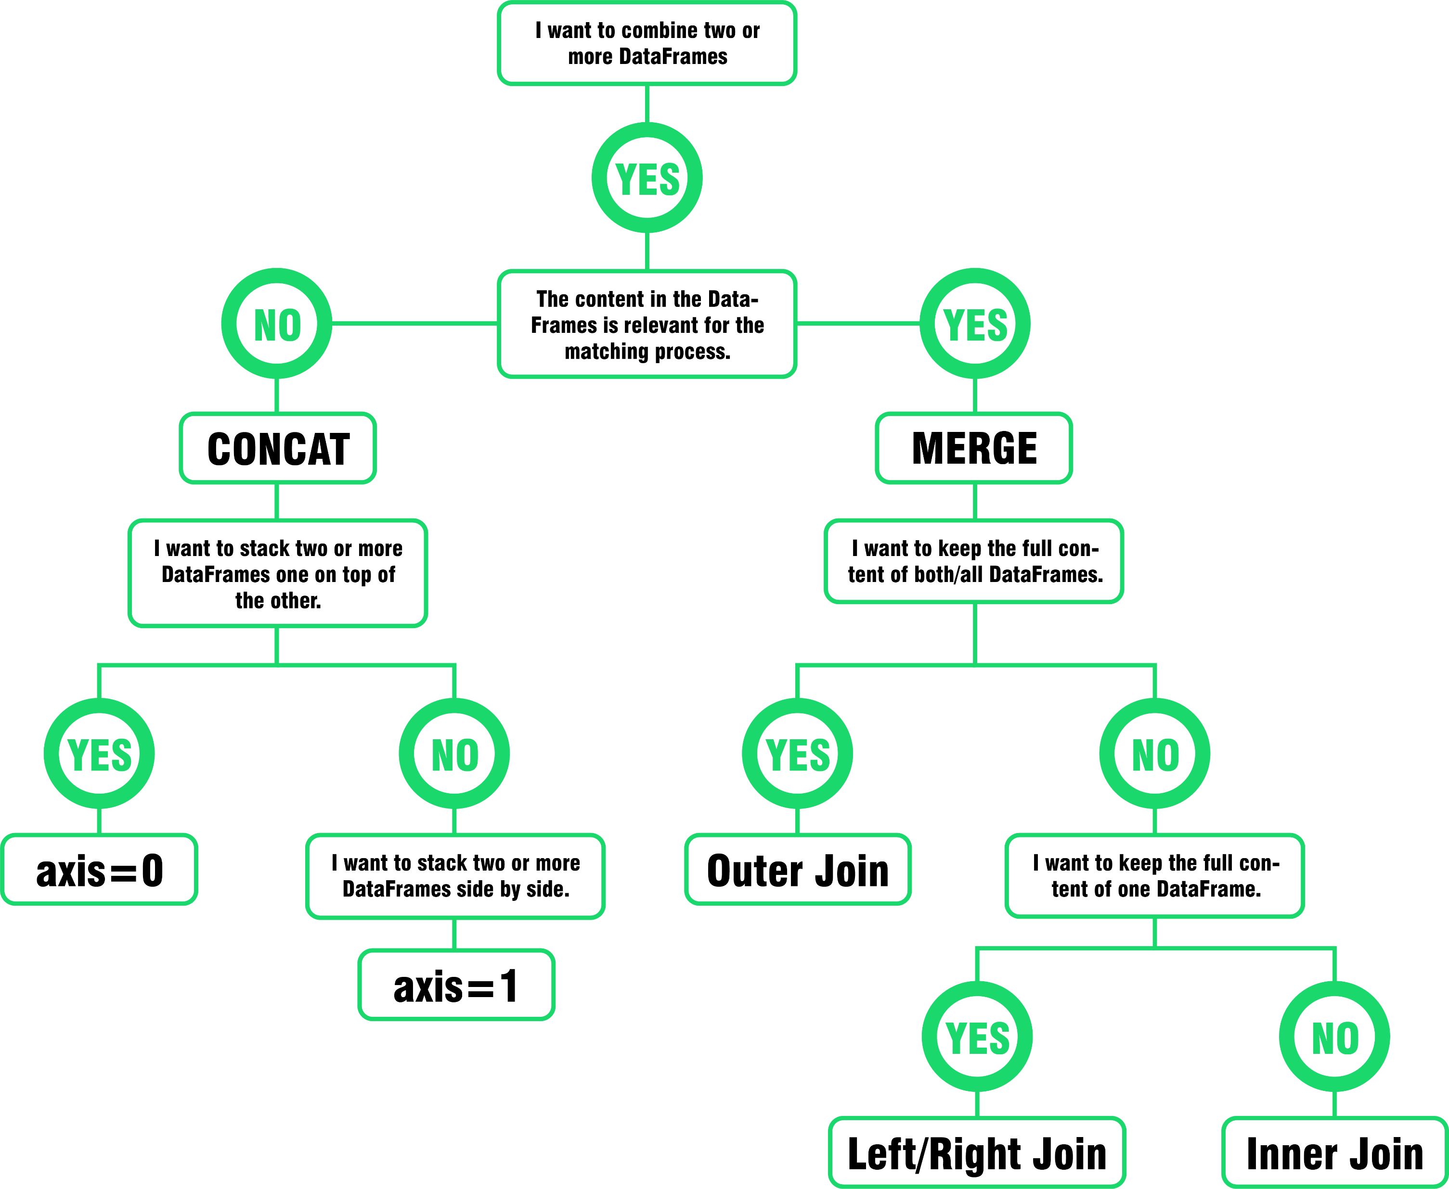
Merging
In this DataFrame, each row is an Uber trip.
Suppose we're asked to plot the number of trips per hour from April 2014 to September 2014.
To tackle this problem, it would be much easier if all the data was in one DataFrame.
There are two Pandas methods for combining DataFrames: .concat() and .merge().

Slide 26
Merging
Is the content in the DataFrame relevant for the matching process?
?

Slide 27
Merging
Is the content in the DataFrame relevant for the matching process?
NO
Do we want to stack two or more DataFrames one on top of the other?
?

Slide 28
Merging
Is the content in the DataFrame relevant for the matching process?
NO
Do we want to stack two or more DataFrames one on top of the other?
YES
.concat(axis=0)

Slide 29
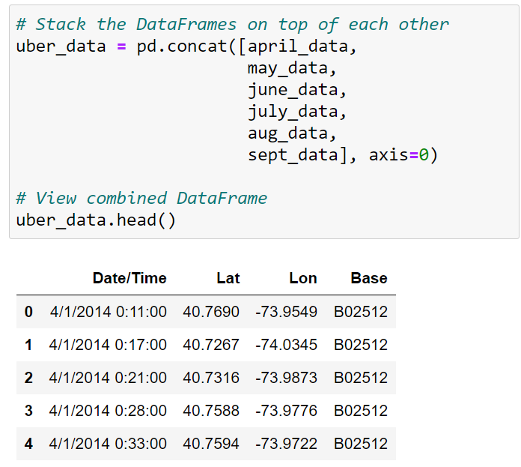
Merging
Concatenate
We use the .concat() function to append either columns or rows from one DataFrame to another. This happens to be the functionality we need to handle the Uber data we import above.
pd.concat() has many features, which you're encouraged to explore, but the basic function is demonstrated below.
If we want to stack multiple DataFrames side-by-side, then we set axis=1.

Slide 30
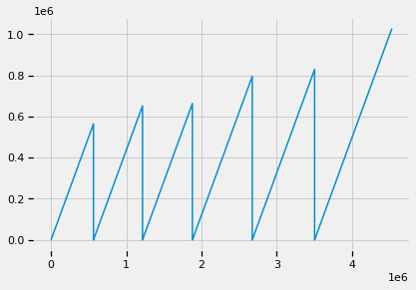
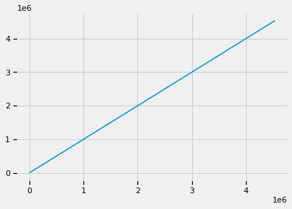
Merging
Concatenate
If we plot the index, we can clearly see from the plot that when concatenating the DataFrames, the original indexes have been preserved, meaning that we have duplicates, which will be an issue moving forward.
To adjust the row index automatically, we can set the argument ignore_index=True while calling the .concat() function.

Slide 31
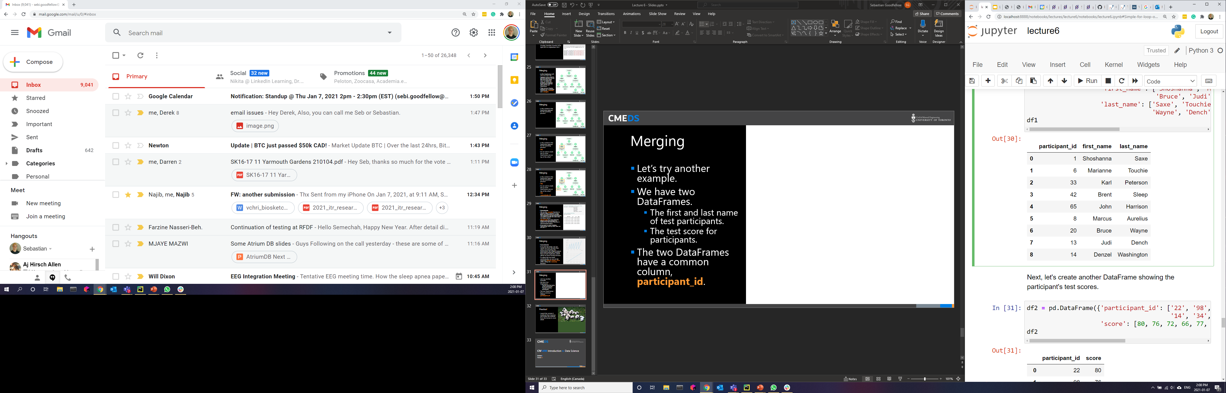
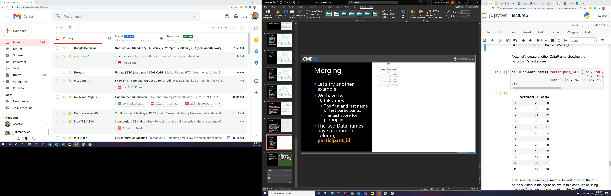
Merging
Left
Right
Let’s try another example.
We have two DataFrames.
The first and last name of test participants.
The test score for participants.
The two DataFrames have a common column, participant_id.

Slide 32
Merging
Is the content in the DataFrame relevant for the matching process?
?

Slide 33
Merging
Is the content in the DataFrame relevant for the matching process?
YES

Slide 34
Merging
Merge
.merge() allows you to execute the following join operations: inner join, full outer join, left outer join, right outer join (see Figure above).
Let’s work through the four paths outlined in the figure to the right.
We’re using .merge() because the contents of the DataFrame are required for combining the DataFrames.
The common column participant_id will be used to merge df1 and df2.

Slide 35
Merging
Merge Outer Join
I want to keep the full content of both DataFrames.

Slide 36
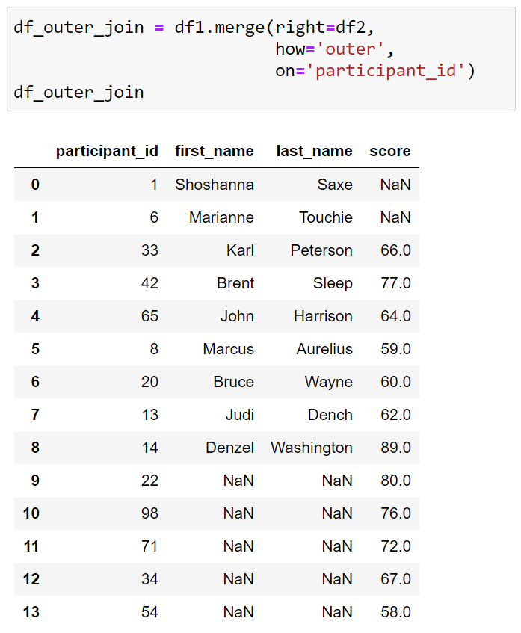
Merging
Merge Outer Join
I want to keep the full content of both DataFrames.
Values not in both DataFrames

Slide 37
Merging
Merge Left Outer Join
I want to keep the full content of the left DataFrame and merge any matching data from the right DataFrame.
Practically, we want a DataFrame with all of the participants from LEFT and we want to merge their scores from RIGHT.

Slide 38
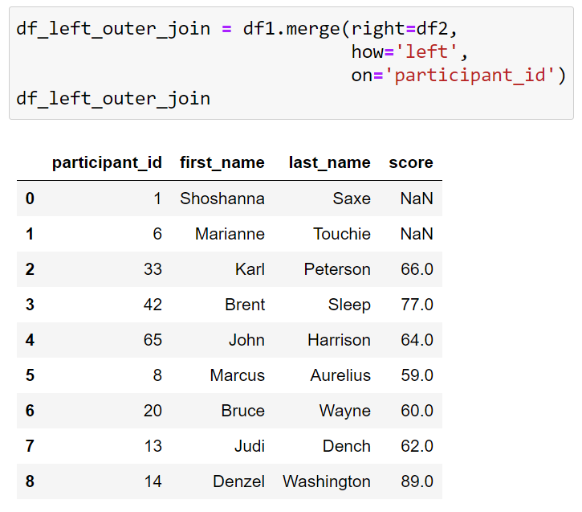
Merging
Merge Left Outer Join
I want to keep the full content of the left DataFrame and merge any matching data from the right DataFrame.
Participants not in RIGHT

Slide 39
Merging
Merge Right Outer Join
I want to keep the full content of the right DataFrame and merge any matching data from the left DataFrame.

Slide 40
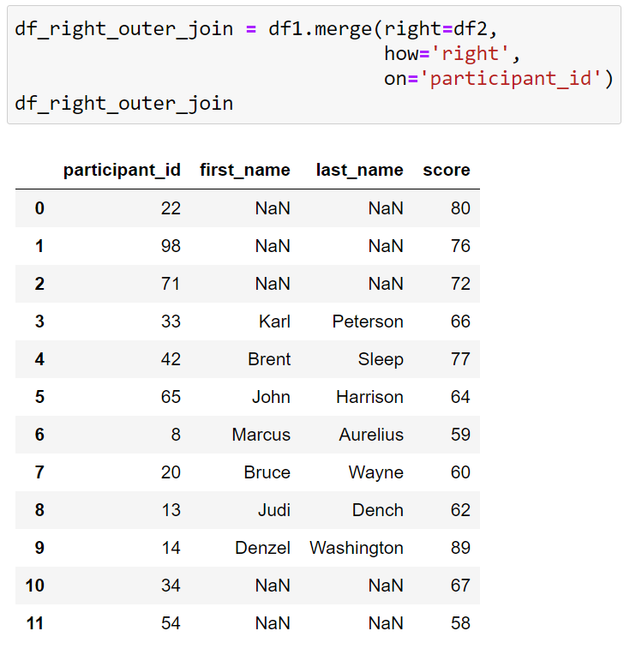
Merging
Merge Right Outer Join
I want to keep the full content of the right DataFrame and merge any matching data from the left DataFrame.
Participants not in LEFT

Slide 41
Merging
Merge Inner Join
I want to keep the only contents of the right and left DataFrame only where overlap.

Slide 42
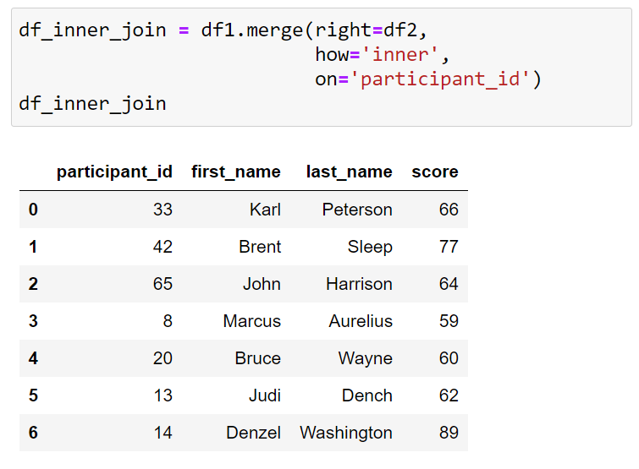
Merging
Merge Inner Join
I want to keep the only contents of the right and left DataFrame only where overlap.
Creates a DataFrame with all of the scores from RIGHT and names from LEFT where they have participant_id in common.

Slide 43
Practice!
Launch the Lecture 2.3 notebook from Quercus and review the material from this lecture in more detail.
Link

Slide 44
CME538 Introduction to Data Science
Week 2 | Lecture 3 (2.3)
Pandas III.

